Slide 1
Mercury

Slide 2
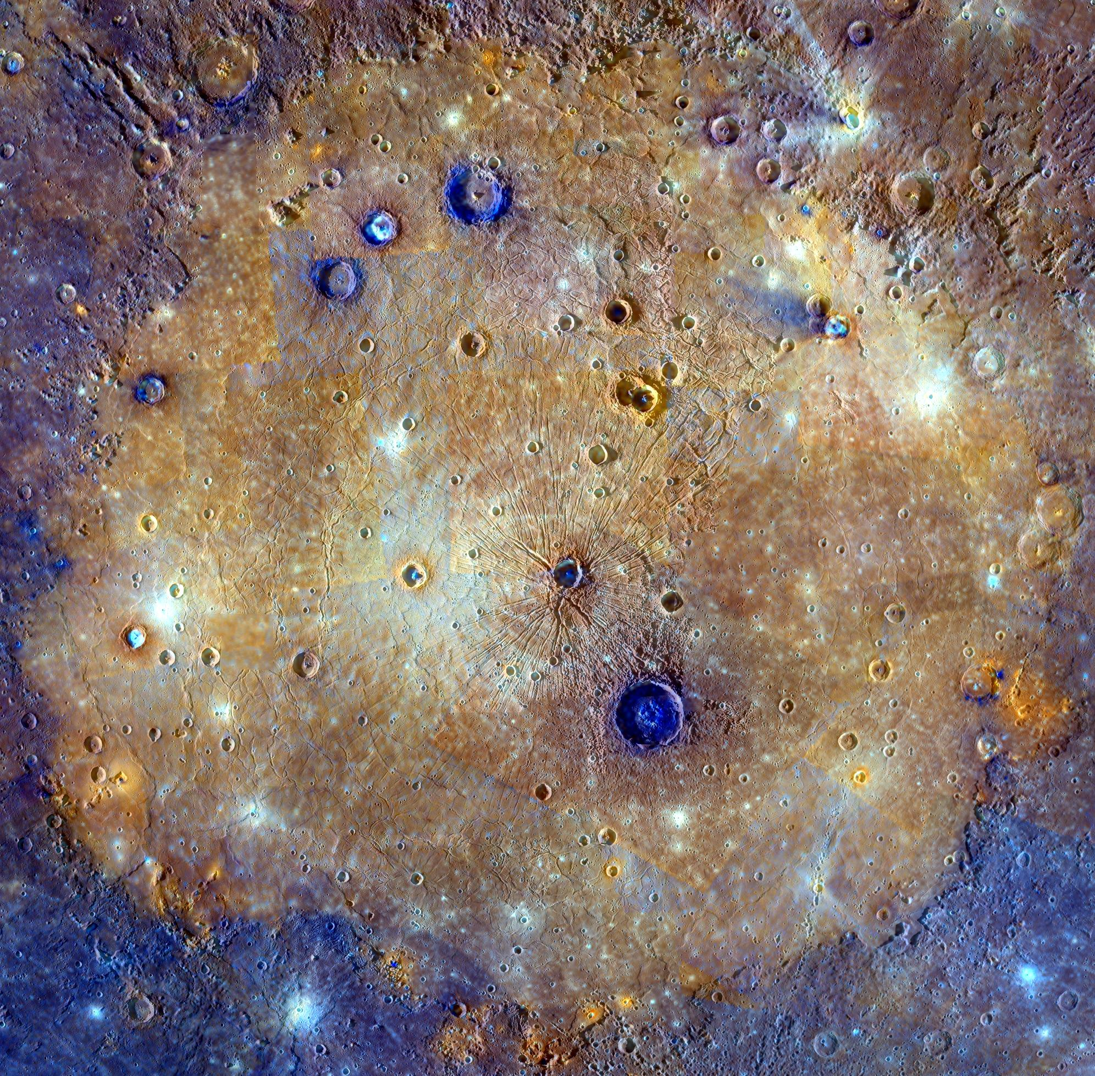
Caloris Basins:
Diameter: 950 miles (1,525 kilometers); Coordinates: 30.5°N 189.8°W

Slide 3
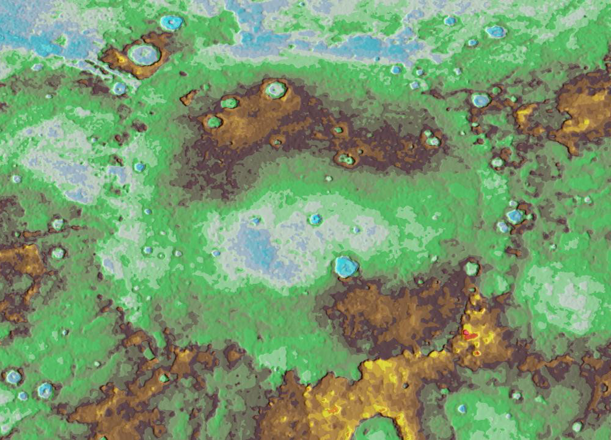
Topographic View Of Caloris basins:

Slide 4
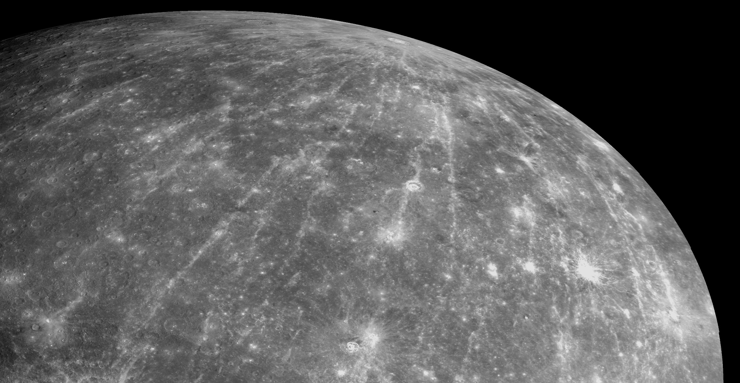
Rays of Hokusai:
Coordinates: crater Hokusai latitude of 58°N; Rays extended thousand kilometers (more than 600 miles) across the planet

Slide 5
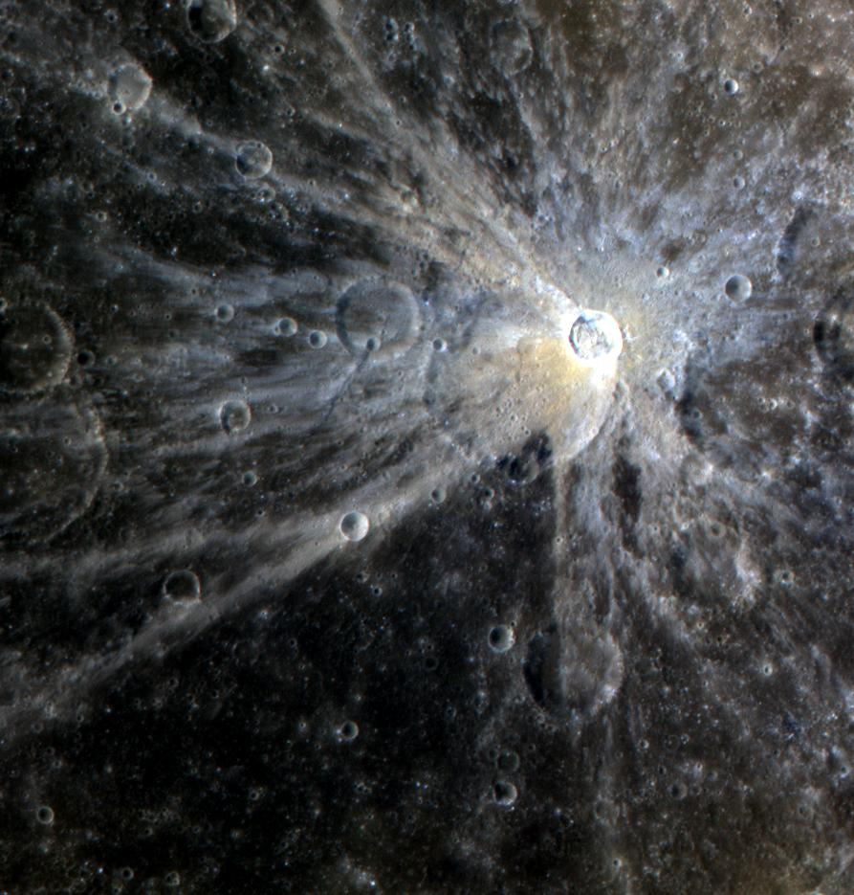
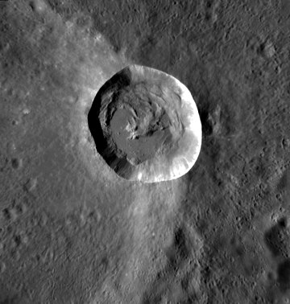
Mena Crater:
Diameter: 15km; Coordinates: 0.17°S 124.73°W

Slide 6
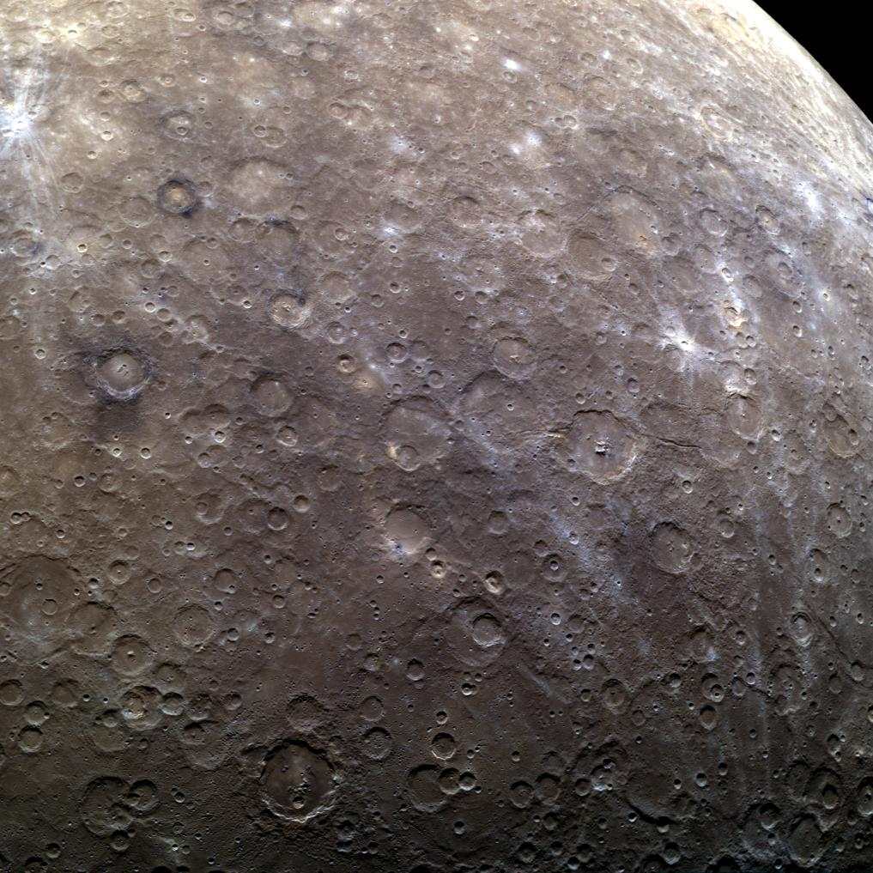
Mercury’s cratered southern Hemisphere

Slide 7
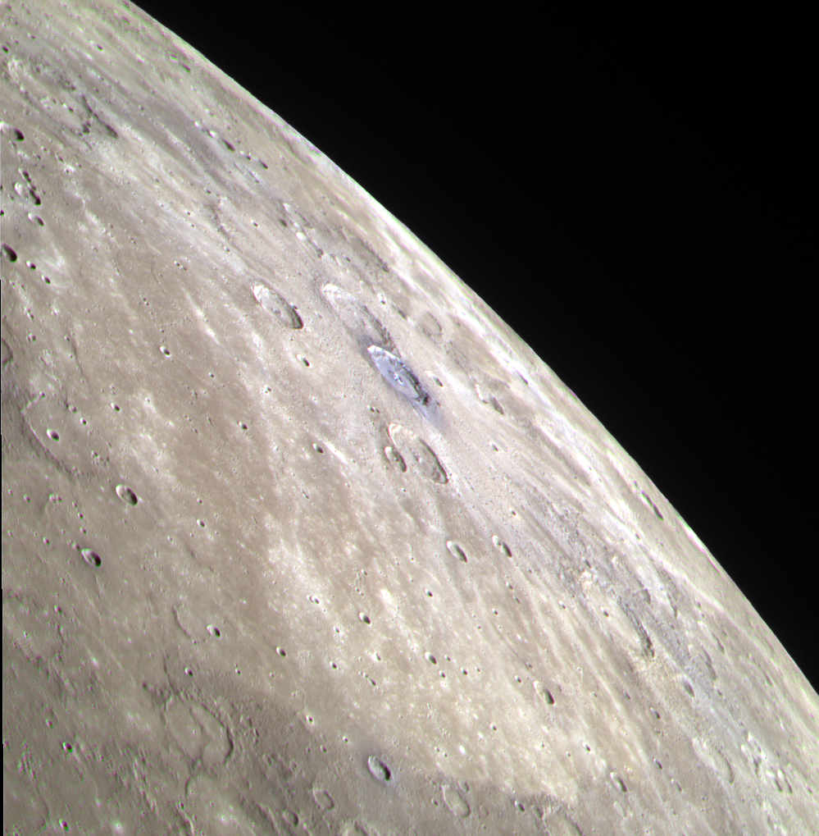
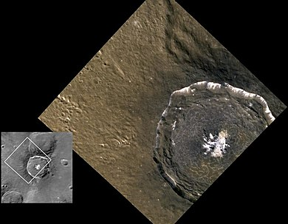
Degas:
Diameter: 950 miles (1,525 kilometers); Coordinates: latitude 37.5 N, longitude 127 W; 37.5°N 127°W
Middle Blue one is Degas

Slide 8
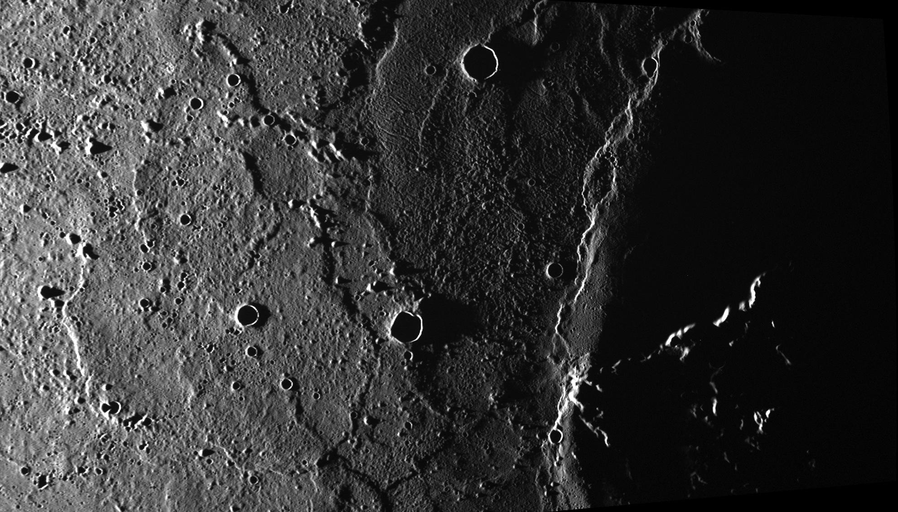
Odin Planitia:
Located at Tolstoj quadrangle at 23.3° N, 171.6° W

